Slide 1

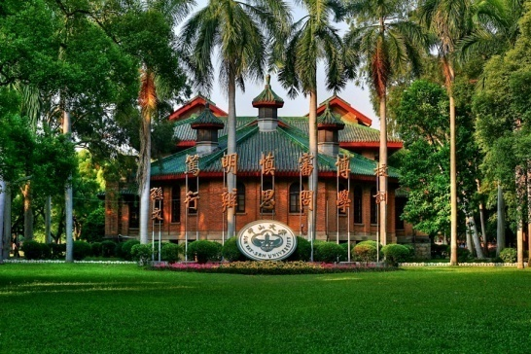
Extended
商家煜
郑铠奇
Deep Learning Foundation

Slide 2

Outline
1
Demo of the project
2
Classification
3
Application

Slide 3
Outline
1
Demo of the project
2
Classification
3
Application

Slide 4
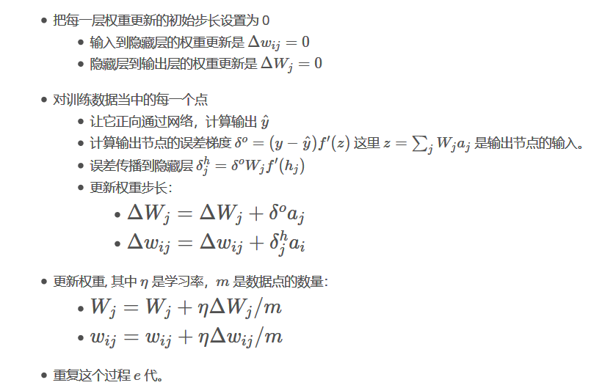
1. Demo of the project
Back propagation neural network

Slide 5
Outline
1
Demo of the project
2
Classification
3
Application

Slide 6
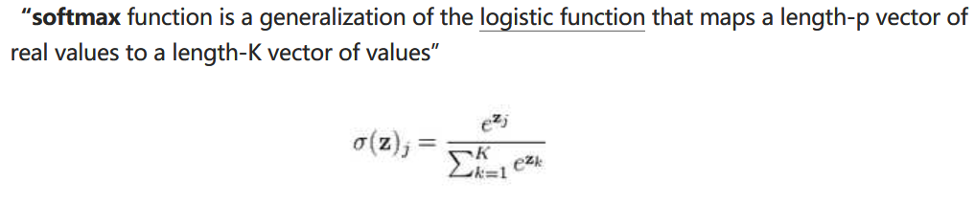
2. Classification
How to do classification using neural network
二元分类：
多元分类：

Slide 7
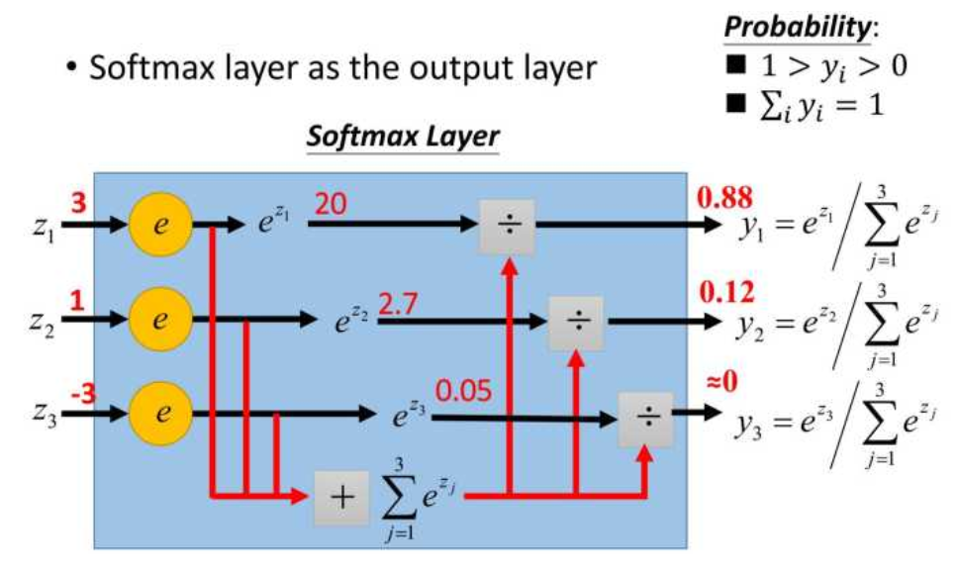
2. Classification
How to do classification using neural network

Slide 8
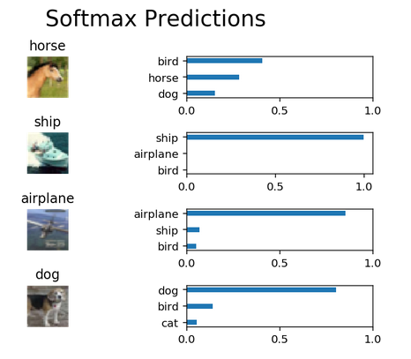
2. Classification
How to do classification using neural network

Slide 9
Outline
1
Demo of the project
2
Classification
3
Application

Slide 10
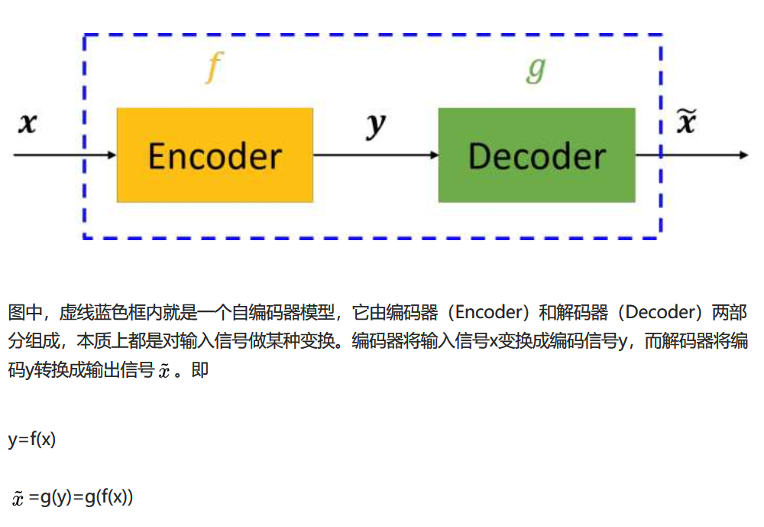
3. Application
Autoencoder

Slide 11
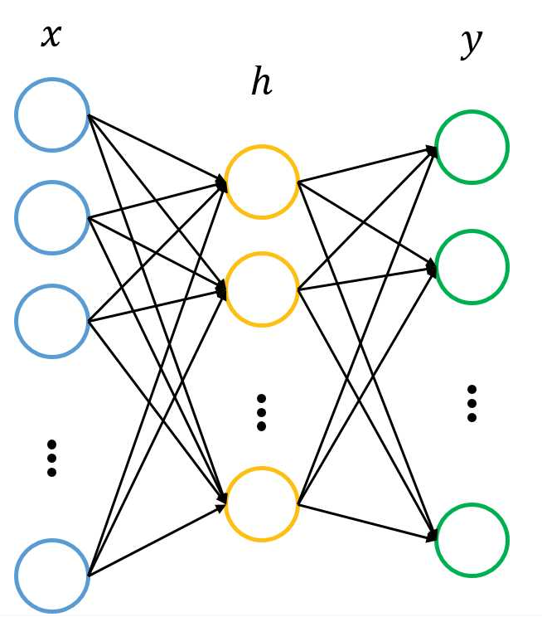
3. Application
Autoencoder

Slide 12
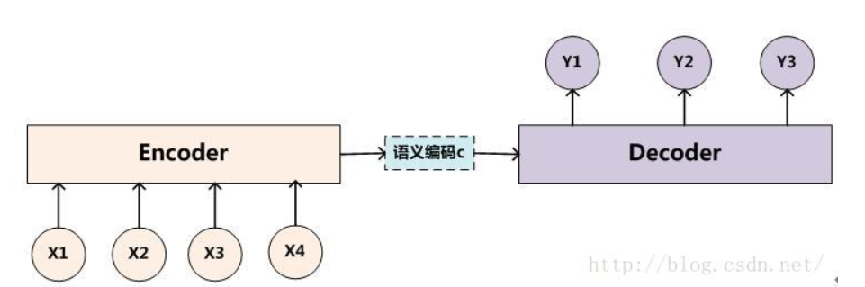
3. Application
Sequence-to-Sequence model

Slide 13
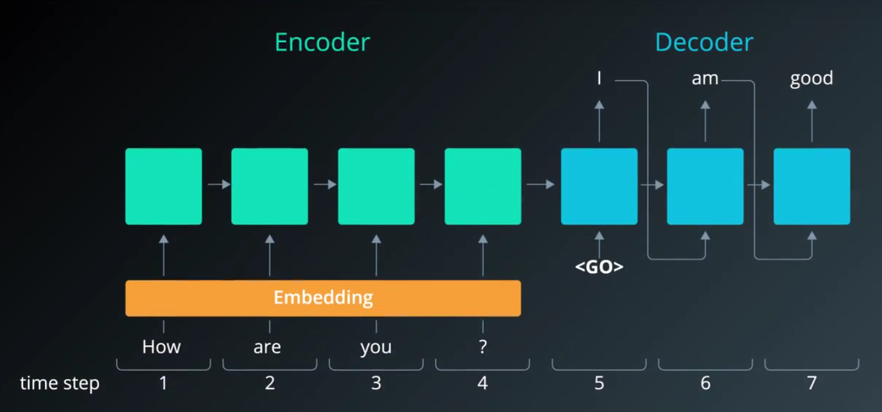
3. Application
Sequence-to-Sequence model

Slide 14
3. Application
Visual Question Answering
Aims to solve the holistic scene understanding problem by teaching computers to capture information
Fig.1 Visual Question Answer

Slide 15
3. Application

Slide 16
3. Application

Slide 17
注意事项
实验报告截止日期：
2017.12.06 晚 23:59:59 前提交至 FTP 文件夹
提交文件：
测试集结果：15******_wangxiaoming.txt 每一行对应的是测试样例的标签。
实验报告：15******_wangxiaoming.pdf
代码：15******_wangxiaoming.zip 如果代码分成多个文件，最好写份readme

Slide 18
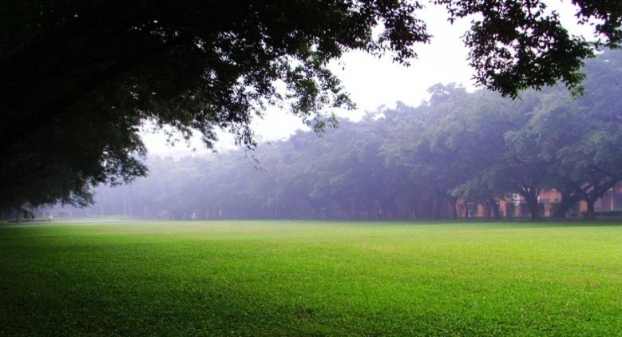
THANKS

